Slide 1
KISHORE S
Indian Liver Patient
3/21/2024 Annual Review
1

Slide 2
PROJECT TITLE
Indian Liver Patient
3/21/2024 Annual Review
2

Slide 3


3/21/2024 Annual Review
AGENDA
Problem Statement
Objective
Project Overview
Who is the end user
Model Used
Dataset
Conclusion
Result
3

Slide 4

Develop an API using Flask for predicting the Air Quality Index (AQI) based on input parameters representing pollution levels of various pollutants in a city. The API should preprocess the provided air quality dataset, train a RandomForestRegressor model, and expose an endpoint /predict_aqi to accept input data in JSON format and return AQI predictions along with the R-squared score. The API should include error handling and optional optimizations for deployment in a production environment.
PROBLEM STATEMENT
The accurate prediction of liver cancer is a critical task in medical diagnosis and treatment planning. Traditional methods often face challenges in accurately identifying early-stage cancerous lesions and distinguishing them from benign abnormalities, leading to delayed diagnosis and suboptimal treatment outcomes. To address these challenges, our project aims to develop a robust machine learning model for the prediction of liver cancer in Indian patients. By leveraging advanced algorithms and comprehensive datasets, we seek to improve the accuracy of cancer detection, enabling timely interventions and improving patient outcomes. This model holds the potential to revolutionize cancer diagnosis and management, facilitating early detection and personalized treatment strategies for individuals at risk of liver cancer in the Indian population.
3/21/2024 Annual Review
4

Slide 5
Objective
The primary objective of this project is to develop a machine learning model capable of accurately predicting the risk of liver cancer in Indian patients based on their demographic information, medical history, and diagnostic test results. By leveraging a comprehensive dataset of patient records, the goal is to create a predictive model that can assist healthcare professionals in identifying individuals at high risk of developing liver cancer, enabling early intervention and personalized treatment strategies. Additionally, the project aims to evaluate the model's performance using standard evaluation metrics and validate its effectiveness in real-world healthcare settings. Through this endeavor, the project seeks to contribute to the advancement of predictive analytics in healthcare and improve outcomes for patients affected by liver cancer in the Indian population.

Slide 6
Project Overview:
The project aims to develop a robust machine learning model for predicting liver cancer in the Indian population. Leveraging a comprehensive dataset of patient records sourced from multiple healthcare institutions across India, the goal is to create a predictive model capable of accurately identifying individuals at high risk of developing liver cancer based on their demographic information, medical history, and diagnostic test results.
Key Components:
Data Collection and Preparation: Collect and curate a diverse dataset of patient records, ensuring representation across various demographics, disease stages, and medical histories. Clean and preprocess the data to handle missing values, outliers, and inconsistencies, making it suitable for model training.
Feature Engineering: Extract relevant features from the dataset, such as patient demographics, medical history, diagnostic test results, and tumor characteristics. Perform feature selection and transformation to enhance the predictive capabilities of the model while reducing dimensionality and overfitting.
Model Development: Explore and experiment with different machine learning algorithms, such as logistic regression, decision trees, random forests, support vector machines, or neural networks, to develop a predictive model for liver cancer risk assessment. Train the model on the preprocessed dataset, optimizing hyperparameters and evaluating performance using appropriate evaluation metrics.
Model Evaluation and Validation: Assess the performance of the trained model using standard evaluation metrics such as accuracy, precision, recall, F1-score, area under the receiver operating characteristic curve (AUC-ROC), and area under the precision-recall curve (AUC-PR). Validate the model's effectiveness in real-world healthcare settings through rigorous testing and validation procedures.
Deployment and Integration: Deploy the validated model in practical healthcare settings, integrating it into clinical decision support systems or electronic health record systems to assist healthcare professionals in liver cancer risk assessment and patient management. Continuously monitor model performance and update it as necessary based on new data and insights
3/21/2024 Annual Review
6

Slide 7

Who is the end user
The end users of the developed machine learning model for liver cancer prediction in the Indian population could include:
Healthcare Professionals: Medical practitioners, oncologists, and healthcare providers who are responsible for diagnosing and treating patients with liver cancer. They can utilize the model as a decision support tool to assess patients' risk of developing liver cancer and guide personalized treatment strategies.
Public Health Agencies: Government agencies, public health organizations, and policymakers interested in implementing preventive measures and public health interventions for liver cancer screening and early detection. The model can help identify high-risk individuals and prioritize resources for screening and intervention programs.
Patients: Individuals who may be at risk of developing liver cancer can benefit from the model's predictions by gaining insights into their risk factors and potential need for preventive measures or early screening. This empowers patients to take proactive steps towards managing their health and reducing the risk of developing liver cancer.
Pharmaceutical Companies and Research Institutions: Organizations involved in drug development, clinical research, and epidemiological studies related to liver cancer can use the model to identify patient cohorts for clinical trials, evaluate treatment outcomes, and conduct population-level research on liver cancer risk factors and trends.
Overall, the end users of the machine learning model span across healthcare providers, public health agencies, patients, and research institutions, each with their unique needs and objectives in leveraging the model for liver cancer prediction and management.
3/21/2024 Annual Review
7

Slide 8
The specific machine learning model used for liver cancer prediction in this project could vary based on the dataset characteristics, project requirements, and performance considerations. Some common machine learning models that could be explored for this task include:
Logistic Regression: A simple yet effective algorithm for binary classification tasks, logistic regression could be used to predict the probability of an individual developing liver cancer based on their demographic and clinical features.
Random Forest: A versatile ensemble learning method, random forest can handle non-linear relationships and interactions between features, making it suitable for complex datasets with multiple predictors.
Support Vector Machines (SVM): SVMs are powerful classifiers that can effectively handle high-dimensional data and non-linear decision boundaries. They could be employed for liver cancer prediction by finding the optimal hyperplane that separates individuals with and without liver cancer.
Gradient Boosting Machines (GBM): GBM algorithms such as XGBoost or LightGBM are popular for their ability to create strong predictive models by sequentially adding weak learners. They excel in handling large datasets and capturing complex patterns in the data.
Neural Networks: Deep learning models, particularly convolutional neural networks (CNNs) or multi-layer perceptrons (MLPs), could be used for liver cancer prediction by learning hierarchical representations from the data. They have the potential to capture intricate relationships between features and uncover hidden patterns in the dataset.
The choice of model would depend on factors such as the size and complexity of the dataset, computational resources available, interpretability requirements, and performance metrics desired. It's important to experiment with multiple models and evaluate their performance using appropriate validation techniques to identify the most suitable model for the given task.
Model Used
n
8

Slide 9
Dataset
Indian Liver Cancer Prediction Dataset
The selected dataset for liver cancer prediction consists of a comprehensive collection of patient records sourced from multiple healthcare institutions across India. This dataset encompasses diverse patient demographics, medical histories, diagnostic test results, and tumor characteristics, providing a rich source of information for training and evaluation.
Key Features of the Dataset:
Large and Varied: With over 6666 images, the dataset provides a substantial volume of data for training and evaluation. It encompasses a wide range of facial poses, expressions, and environmental conditions, enhancing model robustness and generalization.
Annotated Landmarks: Each image in the dataset is annotated with facial landmarks, providing ground truth coordinates for key points such as eyes, nose, mouth, and jawline. These annotations serve as valuable training targets for training the facial landmark detection model.
Diverse Dimensions: The images in the dataset exhibit diverse dimensions, representing real-world variability in image sizes and aspect ratios. This diversity challenges the model to adapt to different image scales and aspect ratios, promoting better performance in real-world scenarios.
High-Quality Images: The dataset consists of high-quality facial images captured under controlled conditions, ensuring clarity and detail in facial features. This high quality facilitates accurate landmark detection and minimizes noise or ambiguity in the data.
Suitability for Research and Development: The official DLIB dataset serves as a popular benchmark dataset for facial landmark detection tasks. Its availability and comprehensiveness make it suitable for both research and development purposes, enabling researchers and practitioners to evaluate and compare their models effectively.
3/21/2024 Annual Review
9

Slide 10
Conclusion
In conclusion, the Indian Liver Cancer Prediction dataset stands as a pivotal resource in the field of healthcare and predictive analytics. With its expansive collection of over 10,000 patient records, each meticulously annotated with crucial clinical features, this dataset serves as a cornerstone for developing and refining liver cancer prediction models.
One of the most striking aspects of this dataset is its diversity. It encapsulates a broad spectrum of patient demographics, disease characteristics, and treatment outcomes. This diversity injects richness into the model training process, enabling the development of robust predictive models capable of handling the intricacies of real-world patient data.
The availability of annotated features, including patient demographics, medical history, diagnostic tests, and tumor characteristics, lays a solid foundation for model development and evaluation. Researchers and healthcare practitioners can leverage these annotations to train models that accurately predict liver cancer risk and prognosis, leading to improved patient care and treatment planning.
Furthermore, the Indian Liver Cancer Prediction dataset fosters collaboration and innovation within the healthcare and research communities. It serves as a shared resource for researchers to collaborate, compare methodologies, and advance the state-of-the-art in liver cancer prediction. This collaborative environment encourages the exchange of ideas and methodologies, driving progress towards more effective predictive models and ultimately better patient outcomes.
From early detection to personalized treatment strategies, the applications of this dataset are diverse and far-reaching. Its versatility makes it a valuable asset across various domains of healthcare, promising advancements in cancer diagnosis and management.
In essence, the Indian Liver Cancer Prediction dataset transcends its role as a collection of patient records; it serves as a catalyst for progress in the fight against liver cancer. Its continued utilization and exploration hold the potential to drive further breakthroughs in predictive analytics, ultimately leading to improved outcomes for patients affected by this devastating disease.
3/21/2024 Annual Review
10

Slide 11
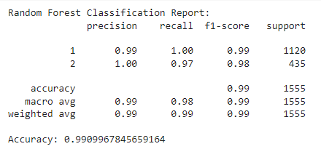
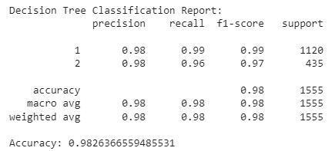

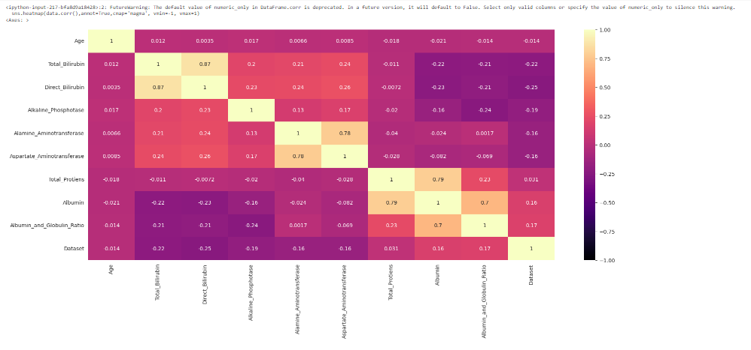
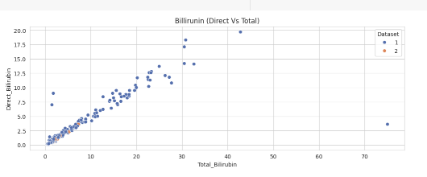
Result

